Slide 1
Formatted File I/O
IN721 2017
Design and Development for Mobile Devices
Session 8.2
You will need pen/pencil and paper for today’s session
Notes:
Last time, we looked at how to access a text file full of useful data from our ~/assets folder.
Frequently, we will want to access data that is not static – that is, not from a file we place in our project when we write it, but data we pull dynamically from the web or a remote database at runtime.
These data sources often return plain text (most efficient for delivery over the internet), but in very specific formats.
To use the data, you have to be able to parse the formats and find the things you need.
Today, we will look in detail at these two text formats.
Next time we will start looking at how we can pull such data at runtime from the web.

Slide 2
Formatted File I/O
XML
JSON
Notes:
These are just text files, so it doesn’t seem like they should be that important, but they are.
Android provides special classes for parsing JSON, and for reading and parsing XML.
The reason we are interested is that when we pull data dynamically off the internet, it will usually be in one of these file formats (think about why internet-transferred data always seems to be text…..)
XML is so special that Android even has a special location for xml files: ~/res/xml – rather than in the ~/assets folder. R will generate a resource ID for them; you’ll fetch them with a Resources instance, and they will be processed more efficiently if they are placed here, rather than in the assets folder.
JSON files go in ~/assets (but I won’t be surprised if this changes in later versions…), but it also has special classes for processing

Slide 3
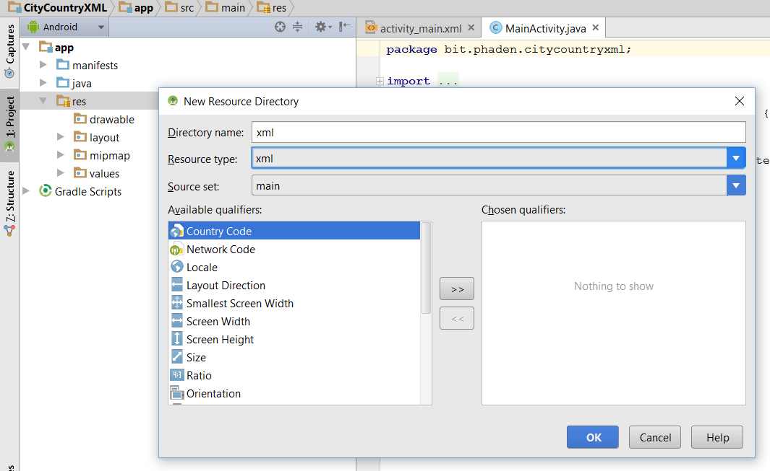
~res/xml
Notes:
You’ll need to create this folder

Slide 4
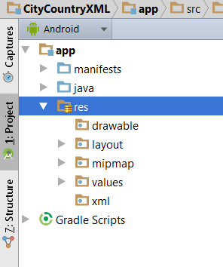
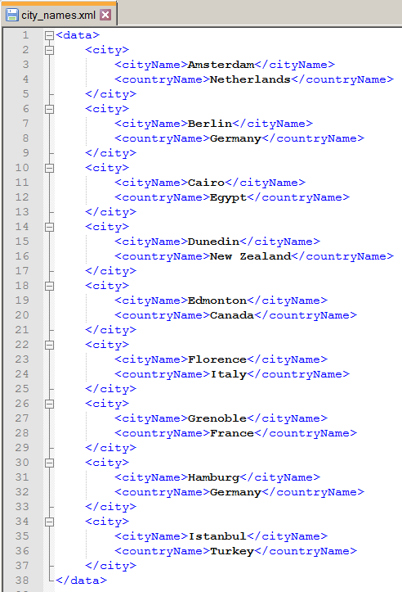
XML Files
Notes:
Here is our XML version of the cities data.
Note the outer element <data>. XML must always have an outer element like this. It is the root of the tree.
Remember that in XML you can do whatever you like. Someone else might, for example, have wanted to make countryName an attribute, or called the root node <places>.
Whatever. This is my schema.

Slide 5
XML Files
Access via a Resources instance
Use to generate an XmlResourceParser instance with the Resources.getXML method.
Important XmlResourceParser methods:
next() – fetches the next token from the XML
getEventType() – indicates what was fetched
START_DOCUMENT
END_DOCUMENT
START_TAG
END_TAG
TEXT
Notes:
XML parsing in Android is actually quite crude (as, for example, how it’s done in .NET, or how JSON parsing is done in Android).
You can think of the parsing of an xml file as proceeding from the first line of the file to the last (or, if you like to think of it this way, doing a depth-first traversal of the tree).
The next() command moves to the next token in the file
getEventType tells you what you got
You will recall that XML files only have tags and values in them, so these are the only things you can end up with.
These constants are contained in the XmlResourceParser class, and need to be fully qualified (see upcoming code samples…)
(NB: attributes also, but we have none in our current XML, so we will leave that as an exercise.)
So basically, you call next() until you get to END_DOCUMENT. At each fetch you check to see if it is the start of a tag that you want and, if so, pull out the text.

Slide 6
XML Files
Fetching the file
Notes:
That’s it.
Note that you don’t put the file suffix on. Because this is a resource ID from R, not a filename
xmlParser is now ready to read the file

Slide 7
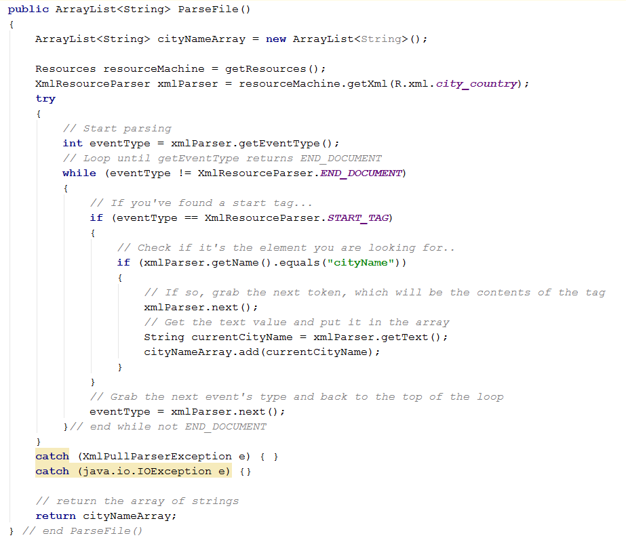
Parsing an XML File
Notes:
It’s a bit primitive.
As we said, we read the file one token at a time.
To see what kind of token you are at, use getEventType(). (Android refers to them as events, which I think it confusing, but they didn’t ask me).
To find out the actual tag, use getName().
To scoop the contents of an element, use getText().
We do one read to get started, then we enter a while loop until we get END_DOCUMENT
For each event, check if it’s a start tag (i.e. The opening tag of an element).
If so, check if it’s one you want by calling getName and inspecting it as a string (in this example, we only want the city names)
If it is, move to the next token. This gets you the text contents of the tag.
Remember that the start tag is one token, and the content of the element is another token, and then the eng tag is another token.
When you have a text token that you want, use the parser’s getText method to grab it.
Add each string to an array that you can then bind to a list view in the normal way.
When you know the structure of the XML file, you can write some very specific code to look for particular data values. But you have to know the schema.
Big official XML schemata have documentation; random things you find floating around may not, so you need to work it out. That can be a problem...

Slide 8
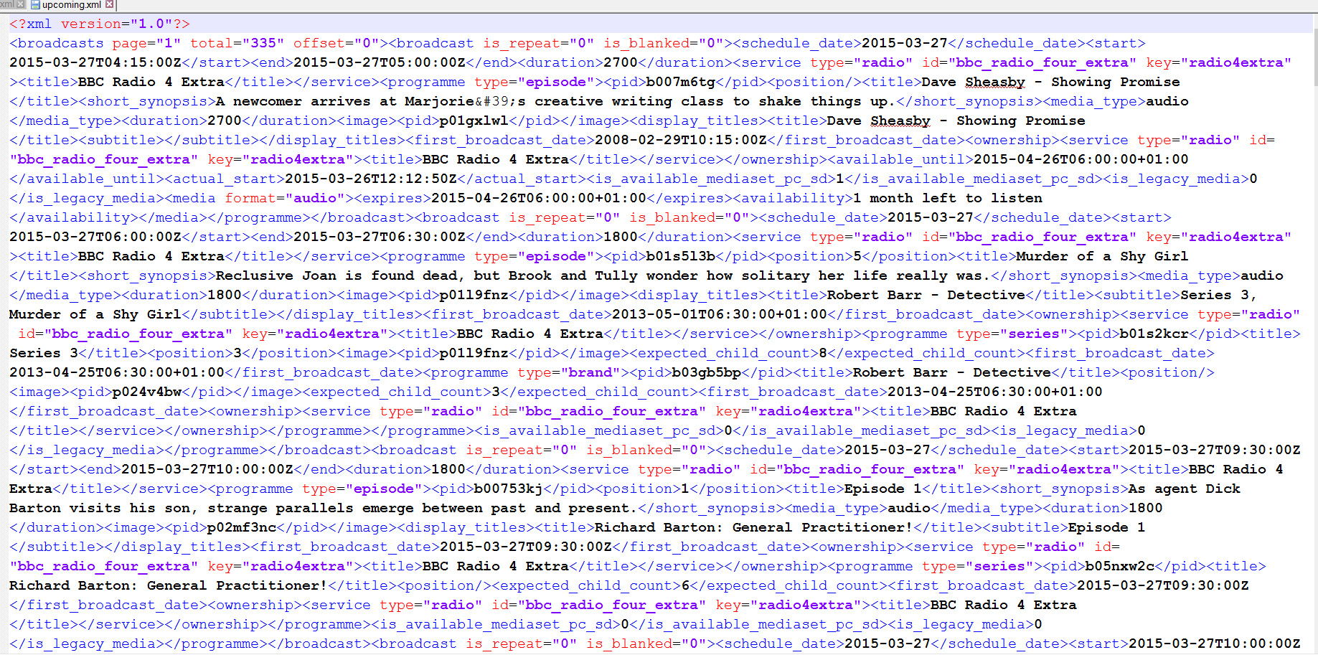
XML for Humans
Notes:
XML files are lean and easy for machines to parse, but they can be quite puzzling for humans.
Here is an XML file pulled from one of the BBC’s dynamic XML feeds
It shows the schedule for drama programmes.
Very difficult to work out the tag structure.
Fortunately, browsers are smart about xml.
If you take that same text file and drop it into an open browser tab, it looks like this...

Slide 9
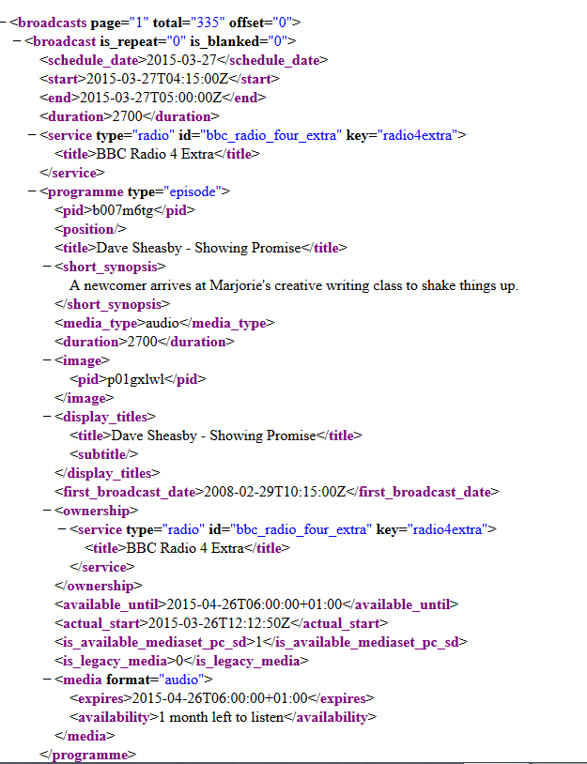
XML for Humans
Notes:
All aligned and coloured and so forth.
Easy to see the tag structure.
You should understand how to deal with XML, and you will do so in the practical, but it is becoming the less important of the two structured data formats as JSON pushes it out of the way. So we’re not going to spend any more time on it, but will instead move on to JSON.

Slide 10
JSON
JavaScript Object Notation
Notes:
JSON (may be a review from Web 1, 2 or 3.)
Our most important, data file format.
JSON is like XML – a text schema for representing hierarchical data
JSON is newer, and rapidly gaining popularity, primarily because it requires fewer characters.
Where XML uses verbose tags, JSON uses {} and [] and other tokens from programming language syntax. It also allows easy indexing into and iteration over collections of elements (while XML does not).
Although called JavaScript Object Notation, JSON doesn’t really have anything to do with JavaScript per se (although it is frequently used as a data representation format in JavaScript code).
It simply uses the same syntactic notation for defining objects (nodes) and arrays (collections of sibling nodes).

Slide 11
JSON – Formal Definitions
Two structures:
Objects: A collection of key-value pairs
Arrays: An ordered list of values
Notes:
We’ll see exactly what a value is in a moment
Let’s look at the formal definition of the JSON syntax rules. These diagrams are worth getting used to. They are often provided to define language rules.

Slide 12
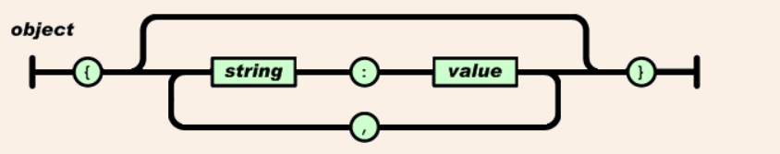
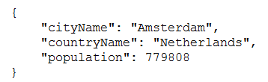
JSON – Formal Definitions
Notes:
Just follow the paths
An object starts with a { and ends with a }
In between there are zero or more elements, separated by commas.
Each element is a string, followed by a :, followed by a value (we’ll see exactly what a value is in a moment)
Here is a simple JSON object. Three key-value pairs; each value a simple scalar string.
If you’ve ever made objects in JavaScript, you will recognise the syntax.
The indentation – and in fact, the line feeds – are irrelevant. That’s just for people. JSON parsers ignore that stuff.
We will see in a moment that the value can actually be quite complicated, allowing for nested structures, multiple structures, etc.

Slide 13
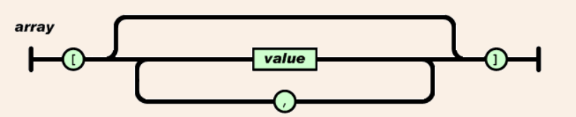

JSON – Formal Definitions
Notes:
An array starts with [ and ends with ]
In between is a comma-separated list of values
Here is a simple example, where the values are just strings.
As mentioned before, value can be lots of things.
Let’s look at the diagram for value...

Slide 14
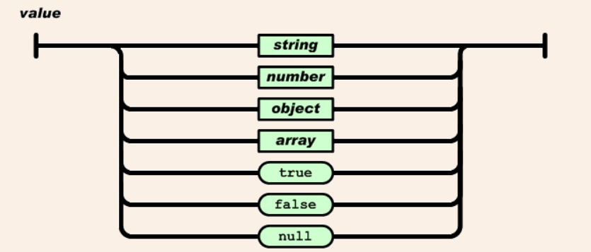
JSON – Formal Definitions
Notes:
So value can itself be an object or an array – the definition is recursive
So in an object, you can have a key-value pair where the value is itself a another object (it will start with {) or an array (it will start with [)
You can have arrays of objects
You can have objects that contains arrays of objects...
And so on.
Let’s look at a possible representation for our city data, adding in population values...

Slide 15
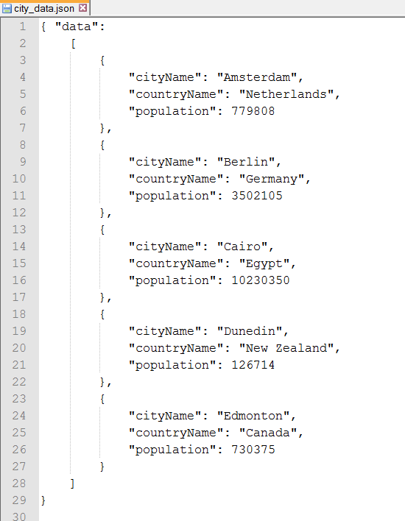
JSON Example
Notes:
(Some cities dropped to allow JSON to fit on slide.)
This JSON file contains a single top-level object.
It has one key-value pair. The key is “data” and the value is an array with five elements.
Each element is an object with three key-value pairs in it.
We can add this file to an Android project by putting it into the ~/assets folder.
Then we can use a streamReader to read it in, and special Android JSON parser classes to parse it.
Although this is a very short JSON file, just for example purposes, you will have an opportunity to work with a more complex one in practical.

Slide 16
JSON and Android
Android classes
JSONObject
JSONArray
Notes:
Android has a class that corresponds to each of the two structures in a JSON representation.
You make variables of these types to hold data components from the JSON input file.
These variables expose methods that allow you to access their children (subordinate/nested elements).
You start at the top by creating a root JSON object from the input file, then you can wander around in the tree.

Slide 17
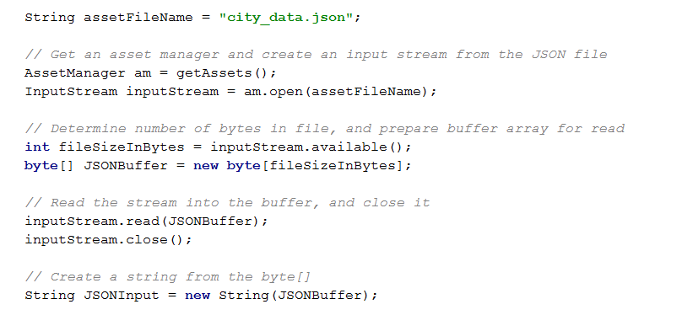
JSON and Android
Read in the entire JSON file
Notes:
Android doesn’t have a swish parser for JSON yet, so we have to pull in all the bytes of our JSON file.
Not line by line, the whole thing at once.
Here is the usual technique.
This is just Java IO stuff, not special to Android
Walk through...
Note that the mandatory exception handling is not shown

Slide 18
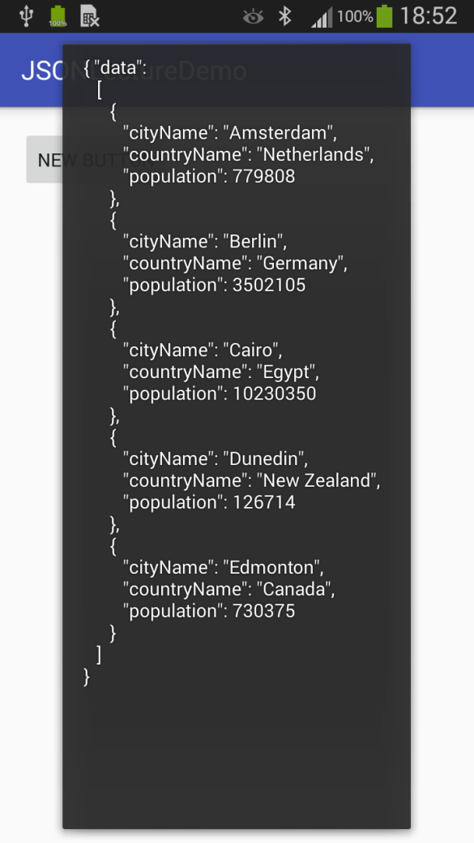
JSON and Android
Read in the entire JSON file
Notes:
The Toast shows us the file has been brought in and made into a string.
Once you have a string holding a JSON data description, you can create a real in-memory JSON object.
You can think of this as implementing the hierarchy in class object instances...

Slide 19

JSON and Android
Convert a String to a JSON object
Notes:
The JSONObject constructor takes a string in JSON format and converts it to a JSON object corresponding to the root node – the outermost JSON Object, in this case “data”.
Like all JSON objects, that object has a key (data) and a value (an array)
And once you have the object, you can wander around in the tree using the various methods of JSONObject and JSONArray.
This is like traversing the DOM in JavaScript/HTML.
Let’s look at their documentation

Slide 20
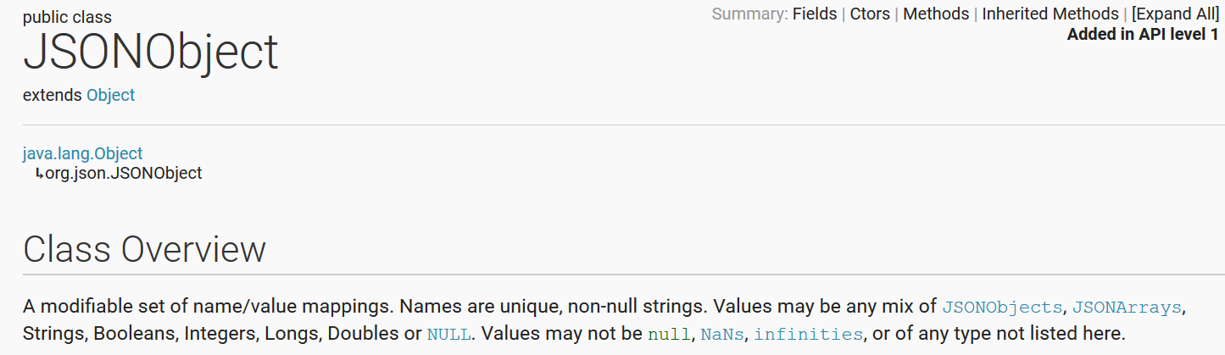
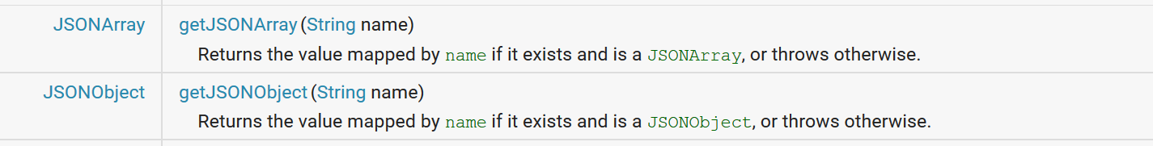
JSONObject
Notes:
The overview, and some handy methods...
If the object contains an array, you can request it by its key
If the object contains another object, you can request it by its key
getString returns the value that matches the key, if the object has that key, and throws an exception if it doesn’t. There are also, getInt, getBoolean, etc.
optString (int, boolean, etc.) also attempts to fetch the value given the key, but if it can’t find the key, it returns an empty string instead of throwing an exception.
Consider carefully which to use in each situation you encounter.
There are many other methods, including all the put options for adding to the JSON. By doing this in memory and writing out the file, you can update your app contents.

Slide 21
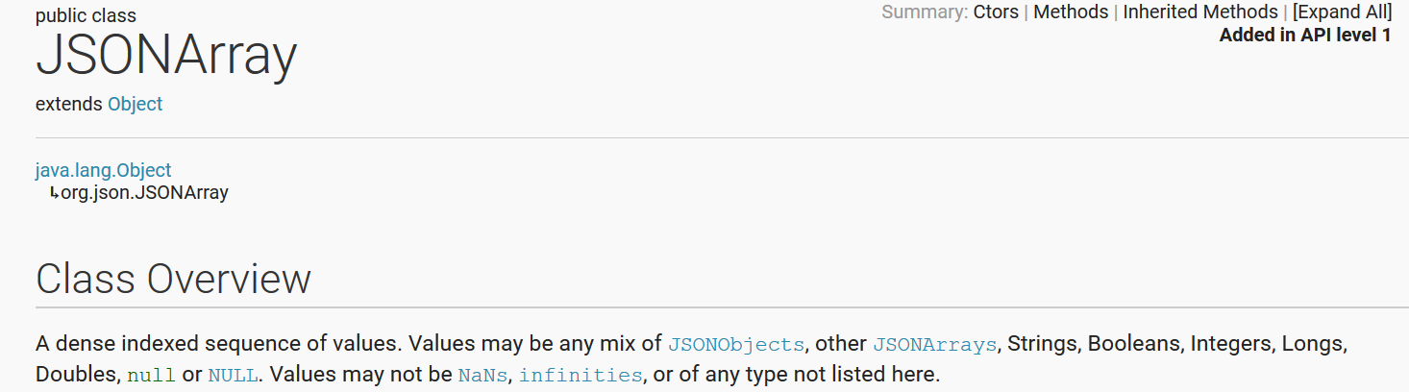
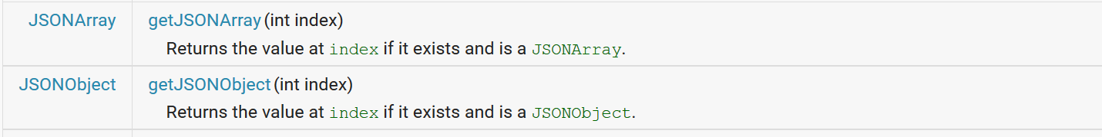
JSONArray
Notes:
As you would expect (since it’s an array), you can fetch elements by index.
This class also has all the opt versions and a bunch more methods, including put(X) which adds to the JSONArray.
Let’s look at some examples using our city data

Slide 22
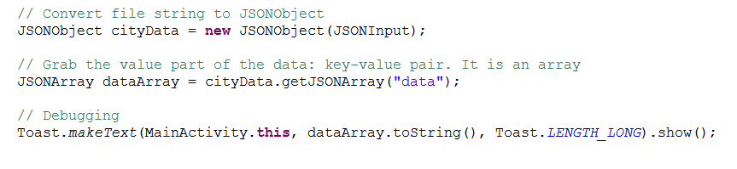
Examples
Notes:
The file shown for your reference...
There’s the line of code we saw earlier, that parses the input string into a JSONObject.
Our JSONObject has one key-value pair, with key = data, and the value = an array.
We can fetch the whole array, like this...
We call a method of that object getJSONArray(key) passing in data, which is the key of our key-value pair.
The call returns the value, which is an array.
The Toast let’s us see it...

Slide 23
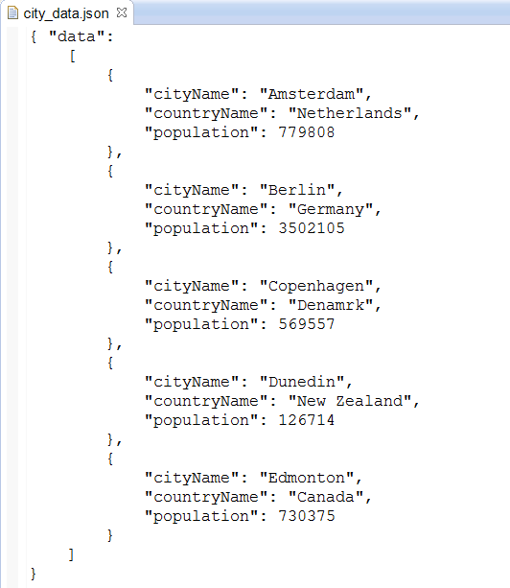
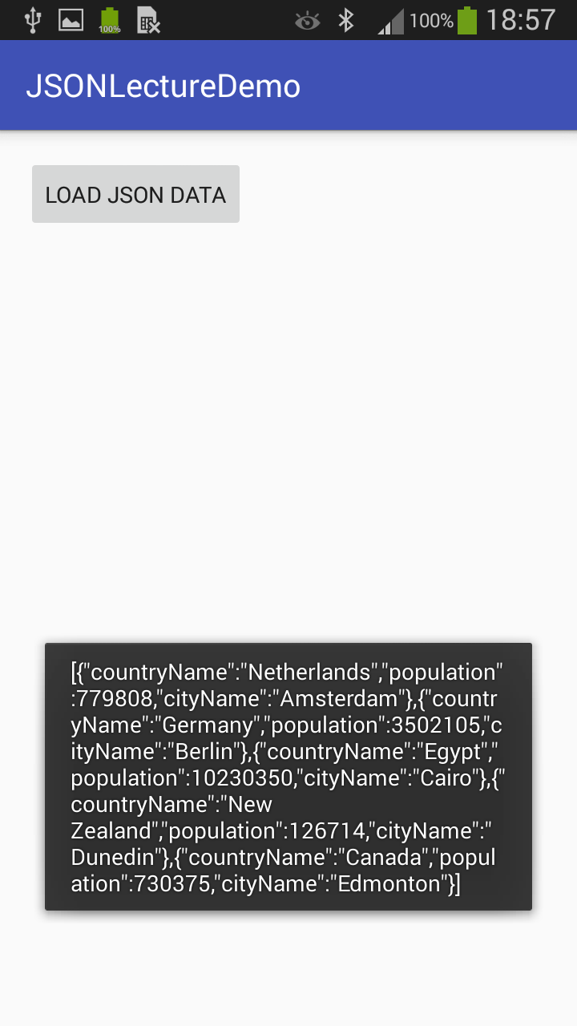
Examples
Notes:
Now we can fetch individual items from this array
Remember that each item is itself a JSON object (note they are wrapped in {})
So that’s what we fetch them as...

Slide 24
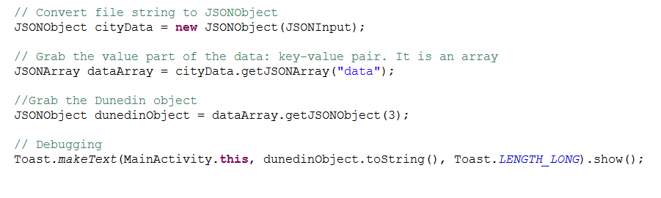
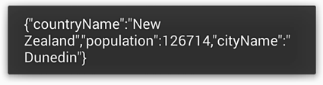
Examples
Notes:
Here we add a line (the third line) to our previous code to fetch it.
The toast shows the object’s toString();
What if we want “Dunedin”, but we don’t know where it is in the array (you usually won’t). What shall we do?
Unfortunately, there is no built-in method for this.
But we could easily write one.
We just need to be able to look at an object and find its cityname value.
That’s just another fetch...
Here’s the code; you can figure out how to make it modular

Slide 25
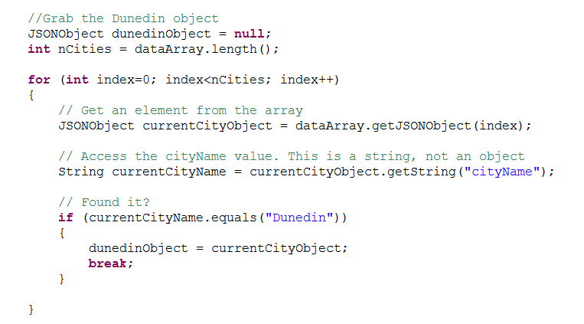
Examples
Notes:
Assume you have grabbed the JSONArray dataArray as shown earlier...
At the end of this loop, dunedinObject holds the element we want.
Note how to compare strings. Don’t use ==

Slide 26
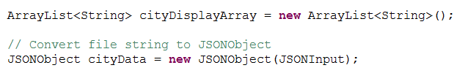
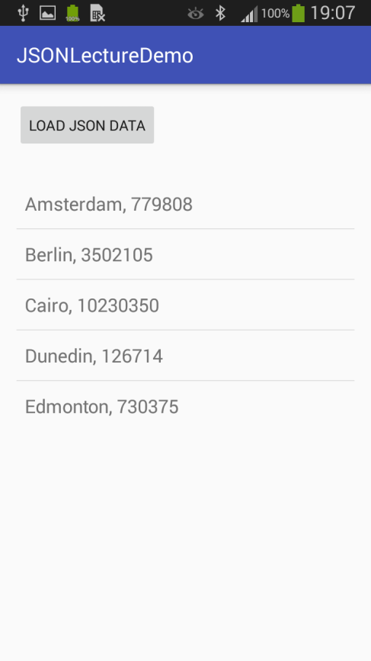
In-Class exercise
Assume the code has been written up to this point:
Notes:
So your file has been parsed into a string and converted into a JSONObject
You have declared a useful string array that you will shove into the ListView
Write the code to fill the string array with the name and population of each city, separated by the punctuation mark of your choice.
I used a comma, and my ListView will look like this.
Don’t write the code to fill the ListView. Just load up the Array you will bind to it (cityDisplayArray)
See IN721_8_2_inclass_solution

Slide 27
Practical
Notes:
It is very important that you get this practical done before next session, because we are going to learn how to fetch data off the internet, and you need to be able to deal with it when it arrives.

